Slide 1
“Automated Timetable generator using CSP (python)”
Presented to:-
Dr. Harjot Kaur
Presented By:-
Kirti
Roll No: 17032456767
B.tech (CSE)

Slide 2
Problem statement
Creating weekly academic timetables manually is time-consuming, prone to errors, and difficult to adjust when constraints change.
Objective:
to build an automated timetable generator using CSP techniques to eliminate scheduling conflicts and reduce manual work.

Slide 3
Project goals
3
Automate weekly timetable generation.
Minimize human efforts and errors.
Ensure conflict-free schedules using a Constraint Satisfaction Problem (CSP) solver.
Easily manage inputs : courses, teachers , rooms, and constraints.
Improve scheduling efficiency for schools and colleges.
Enable easy modifications and update.

Slide 4
Core features
Automatic Timetable Generation: Create timetable based on subjects, teachers, and timeslots.
Clash-Free Scheduling: Avoids conflicts for teachers, classes, and rooms.
Customizable Inputs: Add or edit subjects, periods, days, and rules.
Flexible rules: Supports custom rules like free periods, lunch breaks, and subject frequency per week.
Error alerts: alerts users if the given constraints make it impossible to generate a valid timetable.
User-Friendly: Simple interface for easy use.

Slide 5
Tools And Technologies used
Programming Language : Python
IDE : Visual Studio Code
Library : constraint (CSP Solver)
Version control : Git & GitHub

Slide 6
Key inputs & Constraints
6
Data Required
Courses: Subjects, Duration, Course Blocks
Faculty: Availability, Subjects, Preferences
Rooms: Capacity, Facilities
Time slots: Days, Hours available
Constraints
No class or teacher overlaps
Room usage limits
Faculty workload rules
No subject repeats back-to-back

Slide 7
How it works
Steps:
Input : User provides subjects , days, periods, timing, teachers and constraints.
Processing : Constraint Satisfaction Problem (CSP) solver applies constraints to generate the schedule.
Output : Conflict-free weekly timetable generated and displayed.
Input CSP solver output
Fig : Simple workflow of timetable generation.

Slide 8
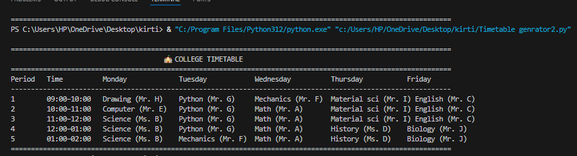
Working prototype
Content:
Accept user inputs : subjects, days, periods, timing and other constraints.
Uses CSP Solver : generate a conflict-free timetable.
Tested : working for basic input cases.
Display output : clear weekly schedule shown in table format.
Fig : Example of generated timetable output.

Slide 9
Work progress
Content :
Researched timetable generation method and requirements.
Designed input structure and constraints.
Wrote core python code using CSP solver.
Tested with various input cases.
Resolved issues (e.g., duplicate subjects, empty slots).
Prepared presentation and working demo.

Slide 10
Source code
Points :
Main code written in Python using Visual Studio Code (VS Code).
Uses the constraint library for CSP solving
Hosted on GitHub with version via Git.
GitHub repository:
https://github.com/KIRTI-6667/Timetable-Generator/blob/main/Timetable%20genrator2.py

Slide 11
Challenges
Points :
Avoiding subject repetition and empty slots.
Ensuring fairness in subject distribution.
Handling multiple constraints simultaneously.
Limited testing time.
Presenting output clearly.
Understanding and using CSP library.
No Graphical User Interface (GUI) yet.

Slide 12
Next steps
Develop a user-friendly GUI.
Export output in PDF PR Excel format.
Test with larger datasets.
Implement additional real-world constraints.

Slide 13
Conclusion
This project demonstrates how CSP can automate and optimize complex scheduling tasks.
This system is :
Efficient
Scalable
Easy to use
Ready for further enhancements
It reduce manual errors and supports digital transformation in educational institutions.

Slide 14
Thankyou “any questions?”

